Slide 1


Watchlist Wizard: Adrian Todd CPSC 3620 Final Project

Slide 2



AGENDA
INTRODUCTION
System Overview
Algorithm Explanation
App Demo
Challenges and Future Improvements

Slide 3
Project Goals:
Build a system that scrapes movie/person data from IMDb
Store data in a robust and normalized relational database for movie data built for CPSC 3660.
Incorporate BFS into the Web Crawler.
Populate the database using data scraped from a real-world source. In this case I used IMDb
Overarching goal was to gain experience using the queue and set data structures in Python to implement a BFS algorithm.

Slide 4

System Overview
Web Crawler:
Uses a BFS to scrape movie and people links from IMDb
Built with Python:
Main Libraries used:
mysql-connector-python
Used to connect to and query DB
requests
HTTP library
urllib
BeautifulSoup
Data structure library for representing parsed HTML
Seleneium
WebDriver to control the browser
nltk
Open-source library for Natural Language processing.
MySQL Database:
Implementation of relational schema design
Central Repository storing structured information scraped from IMDb enabling efficient querying for the Backend API
Backend:
Built using Python and the Flask web application framework
Connects to MySQL database
Responds to API endpoint requests
Frontend:
Next.js frontend implemented with React and Typescript
Allows for user interaction

Slide 5
Breadth First Search (BFS)
Pseudocode for BFS
Function BFS(V ; E; s)
for each vertex v 2 V do
d[v] = ∞
ℼ[v] = NIL
L0 := {s}
i := 0
d[s] := 0
while Li 6= ; do
Li+1 := ;
for u 2 Li do
for v 2 adj(u) do
if d[v] = ∞ then
d[v] = i + 1
ℼ[v] = u
Li+1 := Li+1 U {v}
i := i + 1
Web Crawler BFS
V = Vertices = The set of all reachable URLs from my chosen starting URL. Each URL represents a vertex v
E = Edges = The hyperlinks (mostly <a> tags with href attributes) found within the HTML of one URL that point to another URL. node; relating to the pseudocode, an edge exists from URL u to URL v if page u contains a link to page v
s = Starting Vertex = https://www.imdb.com/chart/top/?ref_=nv_mv_250
In the web crawler I don’t need a loop to pre-initialize all possible URLs because they are discovered dynamically so the for each vertex v in V do loop is not needed.
d[v] = ∞ essentially marks all nodes as unvisited or infinitely far away. In my web crawler I implement this a little differently using a set called visited and if a URL is not in the set that means it has not been processed yet so conceptually its distance is infinity.
ℼ[v] = NIL is used to reconstruct the path taken to reach a node, however the goal of a web crawler is discovery and data extraction, not finding the shortest path back to the start so I don’t need to reconstruct the path taken to reach a node in my implementation.
L0 = {s} maps to initializing my queue with the starting URL
i = 0 I don’t have a variable to increment levels in the same way as the pseudocode, instead the queue data structure being FIFO naturally processes nodes level by level.
d[s] = 0 By adding the start URL to the queue first this basically sets my start distance to 0
While Li != do this maps to my while queue loop that continues as long as there are URLs in the queue waiting to be processed.

Slide 6
Breadth First Search Continued (BFS)
Pseudocode for BFS
Function BFS(V ; E; s)
for each vertex v 2 V do
d[v] = ∞
ℼ[v] = NIL
L0 := {s}
i := 0
d[s] := 0
while Li 6= ; do
Li+1 := ;
for u 2 Li do
for v 2 adj(u) do
if d[v] = ∞ then
d[v] = i + 1
ℼ[v] = u
Li+1 := Li+1 U {v}
i := i + 1
Web Crawler BFS
Li+1 = in the pseudocode initializes the next level of BFS and is not needed in my web crawler implementation as new nodes are simply appended to the existing queue.
This for u 2 Li do loop corresponds to processing a URL popped from the queue, processing the URL is like processing a node u from the current level.
The next for loop corresponds to finding all the valid hyperlinks within the HTML using soup.find_all('a', href=True) or similar which represent the adjacent URLs (v)
If d[v] = ∞ then checks if this neighbor has been seen before in the web crawler this is accomplished by checking the visited set. This step is very important in the BFS implementation logic to avoid cycles and performing redundant work.
Li + 1 = Li + 1 {v} Collects all newly discovered neighbors for the next iteration. In the web crawler this is implemented by adding a new unvisited URL to the end of the queue to be processed after all URLs in the queue from the previous level have been processed.
Again, i is handled implicitly by the queue, once all nodes from the first level are dequeued and their neighbors added, the nodes at the front of the queue will naturally become those belonging to the next level.

Slide 7
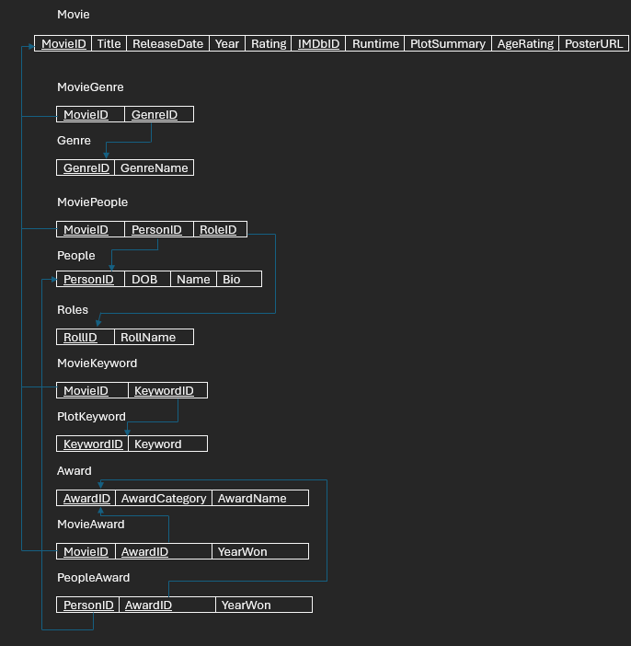

Slide 8
Web App Demo

Slide 9
Challenges & Future Improvements
Web Scraping Data:
Initial sleuthing through IMDb’s HTML to find the right elements and classes containing the data I wanted to extract.
Handling Dynamically loaded content.
Learning about the limits placed on web scraping. robots.txt and adding delays to limit how fast my web scraper was submitting requests.
Structure of Movie Awards on IMDb:
So many different types of awards so the data was going to be to time consuming to parse and scrape.
Implement User accounts and a recommendation algorithm:
Add user accounts system so they can keep track of watched movies, create a watchlist, and rate movies they have watched.
Add TV Show Data
Expand the depth of web crawling.

Slide 10

Conclusion
Successfully implemented the BFS algorithm in the creation of a web crawler that can scrape movie data on the internet.
Used queue and set data structures to assist in scraping data.
Demonstrated ability to populate a database via web scraping.
Built a solid foundation for a web application movie recommendation system.
And.. That’s a wrap for this presentation.

